Slide 1
A Web portal for providing assistance to Autistic Children
External Guide: Dr. K.Raghavendra (Scientist ‘SG’, ADRIN (ISRO)
Team A38
Team Members:
B Advitha(1602-18-737-004)
N Lokesh(1602-18-737-022)
A Nishith(1602-18-737-301)
L Deepthi(1602-17-737-011)
Internal Guide: Ms.L. Divya

Slide 2
Objective
To develop a website for Adya SMILES Foundation NGO
SMILES Foundation helps students with special needs(both special education and alternative education populations),they offer special programs for autistic children/students.

Slide 3
Abstract
Autism spectrum disorder (ASD) is a neurological and developmental disorder that affects how people interact with others, communicate, learn, and behave. Although autism can be diagnosed at any age, it is described as a “developmental disorder” because symptoms generally appear in the first two years of life. In this project, we developed a website SMILES SPECIAL SCHOOL for Adya SMILES which is an NGO for autistic or special children.
To contact a doctor or a therapist, the user must fill out an appointment form. The user must fill in details such as socio-demographic information, the mother's pre-natal, natal, and post-natal information, family history, play history, school history, and employment history. They can also use M-CHART to determine whether their child has autism. HTML, CSS, JavaScript, Bootstrap, PHP, and SQL were used to create this website.

Slide 4
Introduction
The project ‘A Web portal for providing assistance to Autistic Children’ is a web-based application. SMILES serves all types of students with special needs (both special education and alternative education populations). SMILES offers highly effective and efficient alternative schooling options for students who need to be placed outside of public school and classrooms due to a variety of disabilities, deficits, or individual students, parent groups, public school systems, large and small, and sometimes with private education organizations, when applicable, to best meet the needs of these students in non-traditional settings. It also offers special program for Autism.

Slide 5
Contd..
SMILES is based on three A’s.
Acknowledge, Appreciate and Accept.
It acknowledges an autism child’s need to be a part of the society,
Appreciates the true potential of the child and
Accepting is the first step towards the child being inclusive.
Students can register and learn skills offered by this organization through this website

Slide 6
Contd..
Supportive services offered by SMILES are
Speech-Language Therapy,
Special Education
Occupational Therapy,
Physical Therapy,
Music Therapy,
Adaptive Physical Education,
Social work services,
Counselling (Individual, Group & Family),
Life skills and Social skills Training,
Psychological Assessment, Psychiatric Consultation & Evaluation.

Slide 7
Literature Survey
S.No. | Organization website | Name of the organization | Summary
1. | www.cdcwc.com | CDCWC(Child Development Clinic & Wellness Center) | Physical and mental health guidance and also offers therapy sessions. Website is built using HTML, CSS and JS.
2. | Autism-india.org | Action for Autism(AFA) | AFA support and services to persons with autism. First website for autism in India. Website is built using HTML, CSS and JS.
3. | icddelhi.org/Autism.html | Institute for Child Development | The organization provides training and therapy sessions. Website is built using HTML, CSS and JS.
4. | www.communicationdeall.com | Communication DEALL (Developmental Eclectic Approach to Language Learning) | Initiated Early intervention program for children suffering with language disorders.

Slide 8
Software Requirements
VS code editor
Mysql
Xampp server
Technologies Used:
HTML , CSS , Bootstrap, PHP

Slide 9
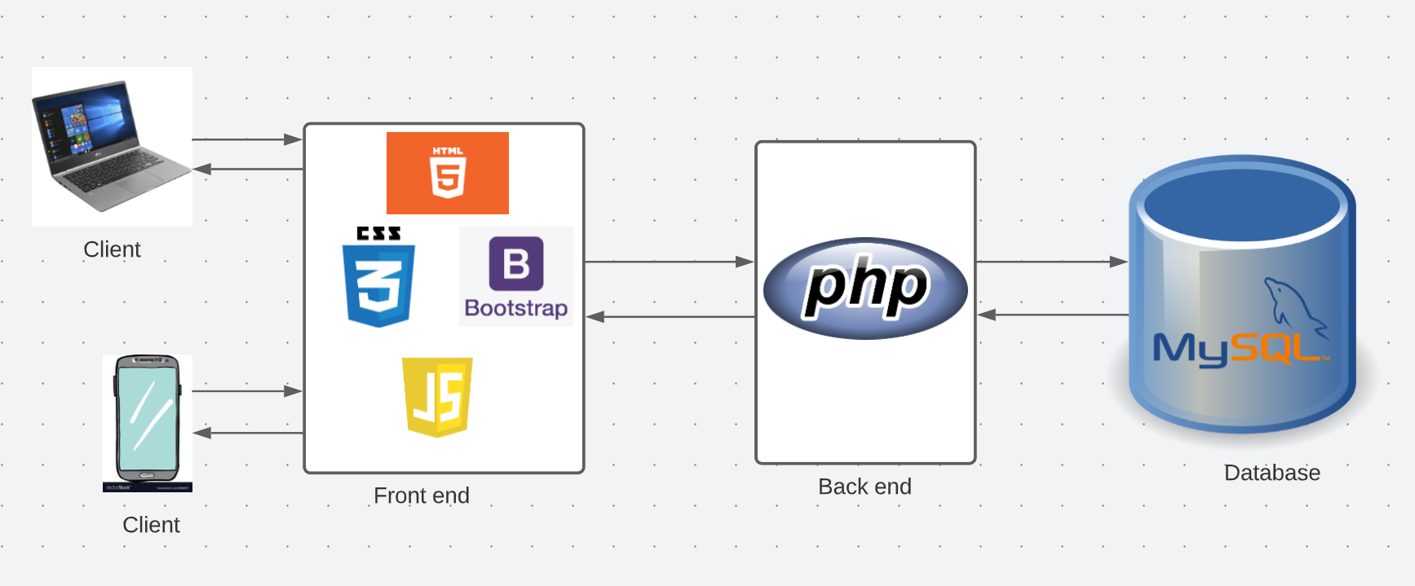
Architecture Diagram

Slide 10
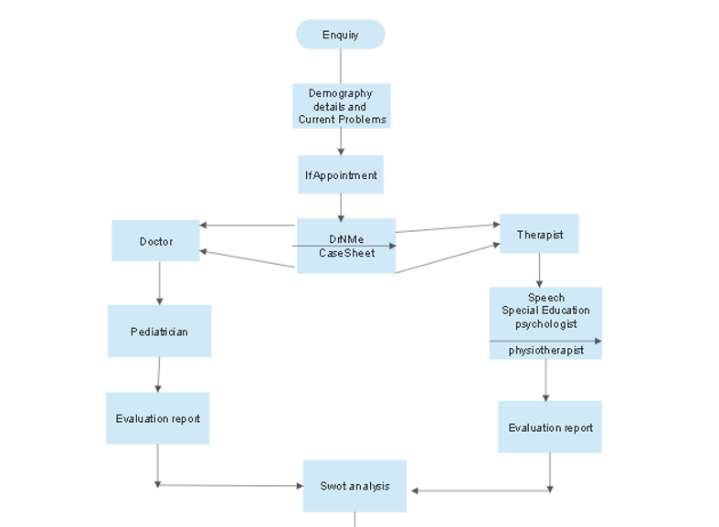
Data flow diagram

Slide 11
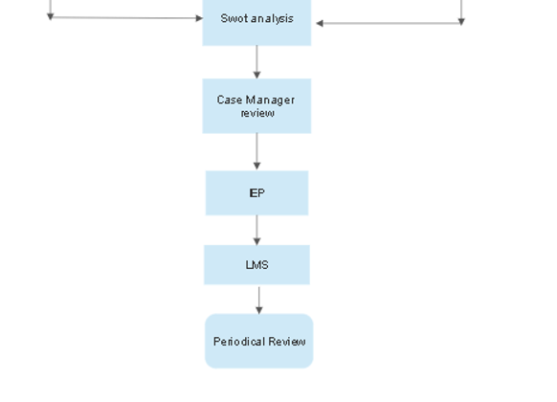

Slide 12
Flow:
1) The user should fill the basic enquiry/consultation form for consulting with the team.case history performa and M chart when they visit the website if they want to know whether
their child suffers from autism.
2) If the user wants to know whether their child suffers from autism they have to fill case history performa and M chart.
3) Case history performa contains basic demographic details along with prenatal,natal and post natal details and school , social and family history.
4)If the user wants to consult a doctor or therapist or both,they should opt for them.
5) The doctor is pediatrician and the therapist could be speech, special educator, Physiotherapist, psychologist.

Slide 13
Contd..
6)The user should pay the consultation fee for consulting doctor or therapist.
7) The doctor or therapist will evaluate the child using the details provided and prepare a report.
8) Using Doctor’s report and therapist’s report , swot analysis is done.
9) Case manager reviews all inputs and coordinates with the respective therapist for developing an individual education plan - IEP
IEP is a typical course LMS system where we track all students' learnings, progress reports, topics split to parents for homework, etc.

Slide 14
Contd..
10) Case manager will schedule reassessment at least each 6 months duration for existing students, compile seronegative reports using comparative analysis.
11) Case manager is the only person who has the authority to intervene in both medical and therapy screenings.
12) Case manager effort will be done through AI by default, and manual review can also be done.
13) Since this is a typical OUTPATIENT module, we might ask students or patients to submit previous medical records and upload them for our internal reference.

Slide 15
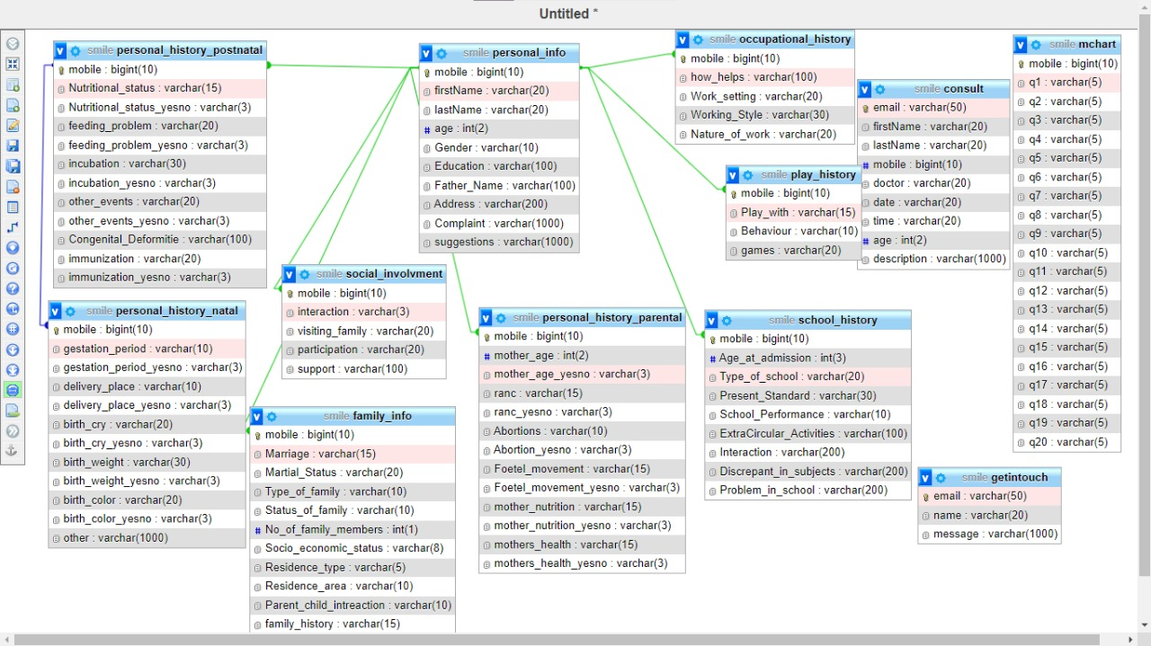
Database schema of this website

Slide 16
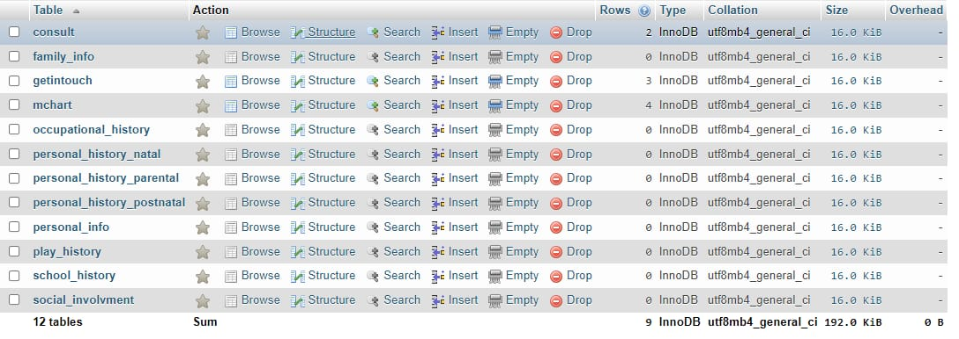
Tables created in the database

Slide 17
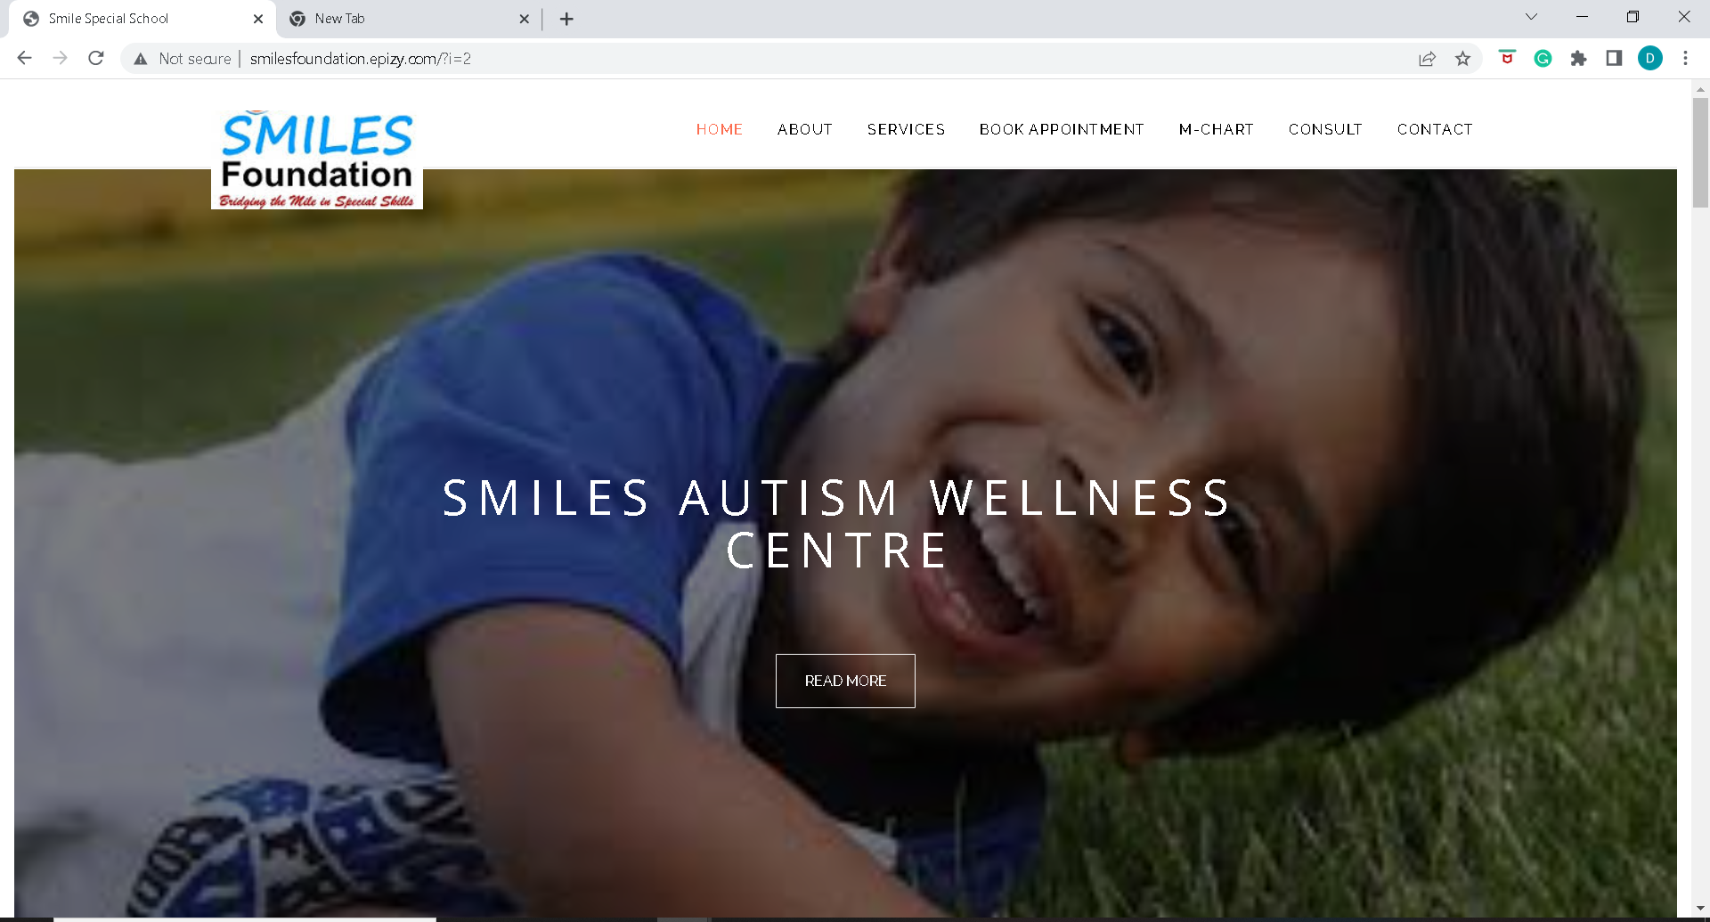
Results
The Home page of the website

Slide 18
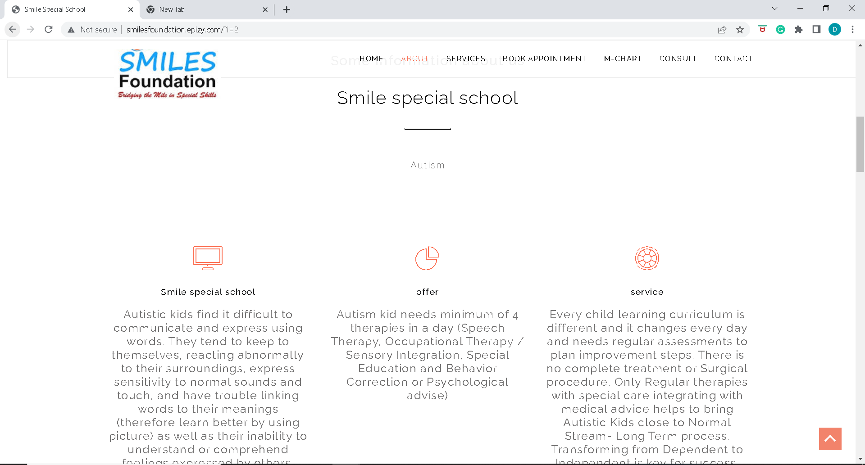

Slide 19
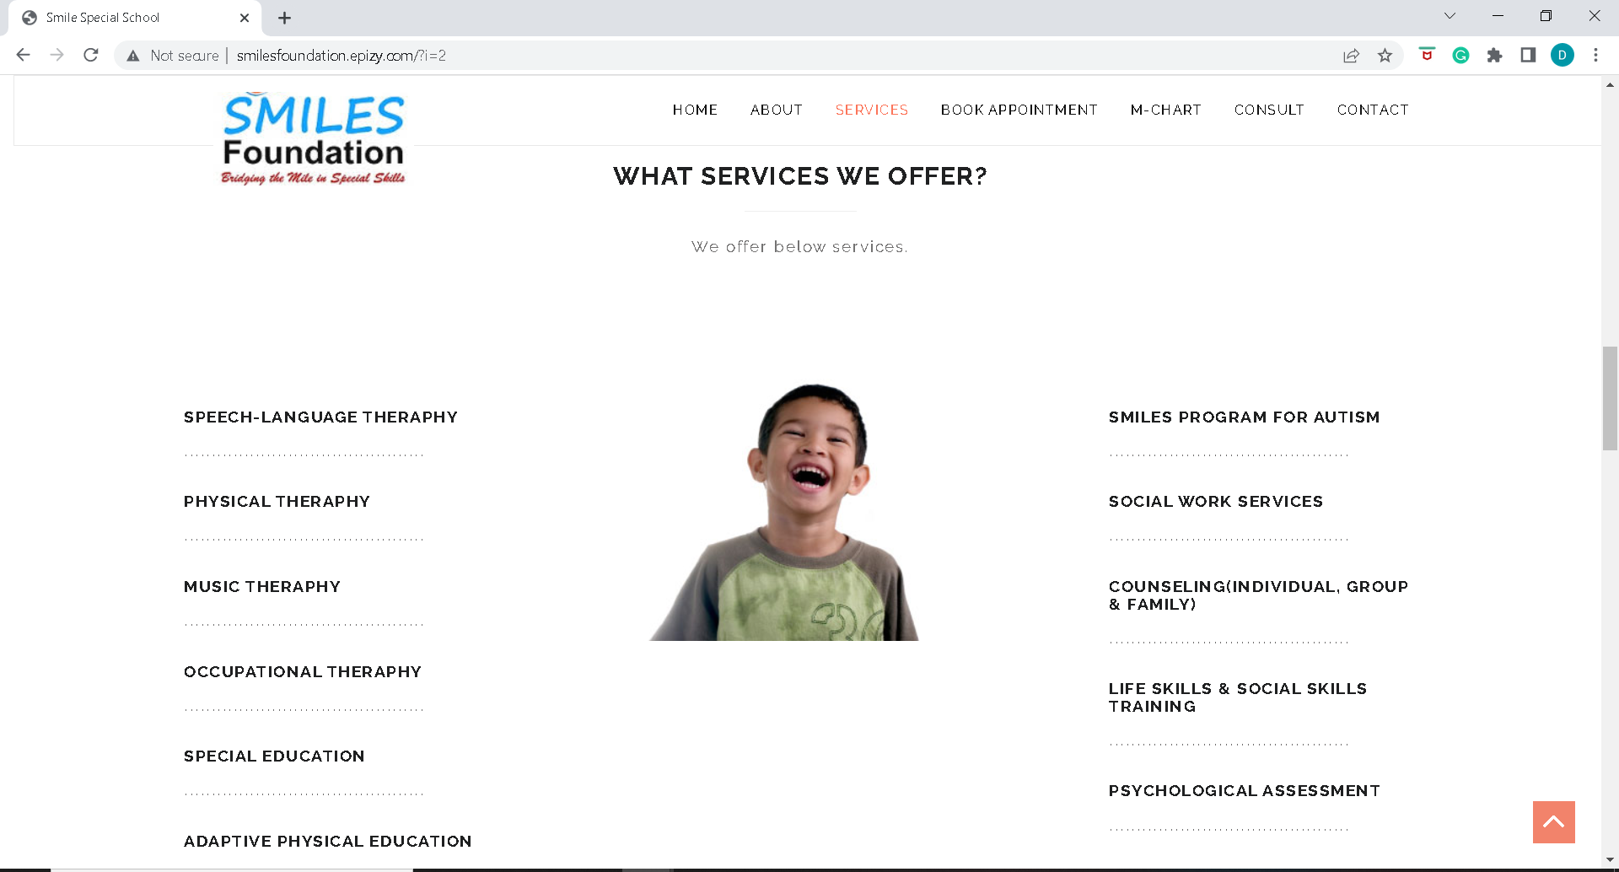
Various services offered by this website

Slide 20
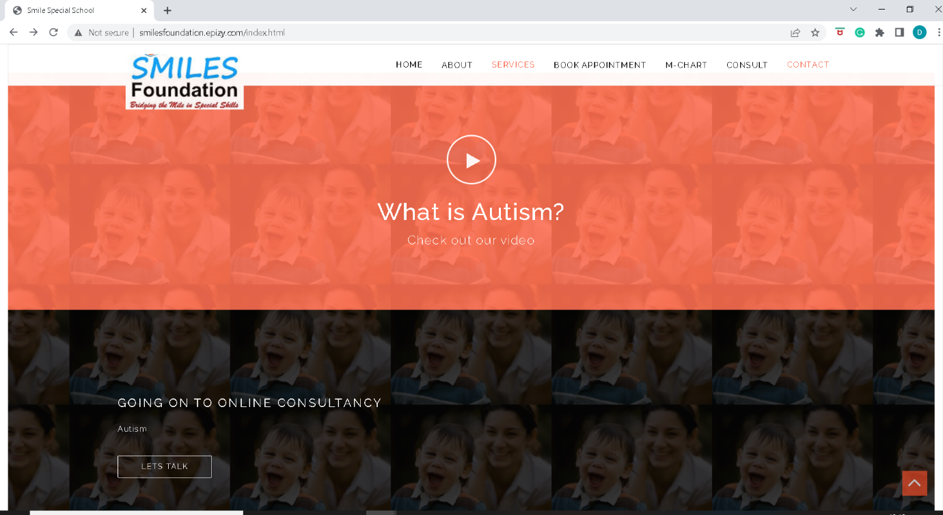
If the user clicks on this button which is on the homepage, a video about autism is played.

Slide 21
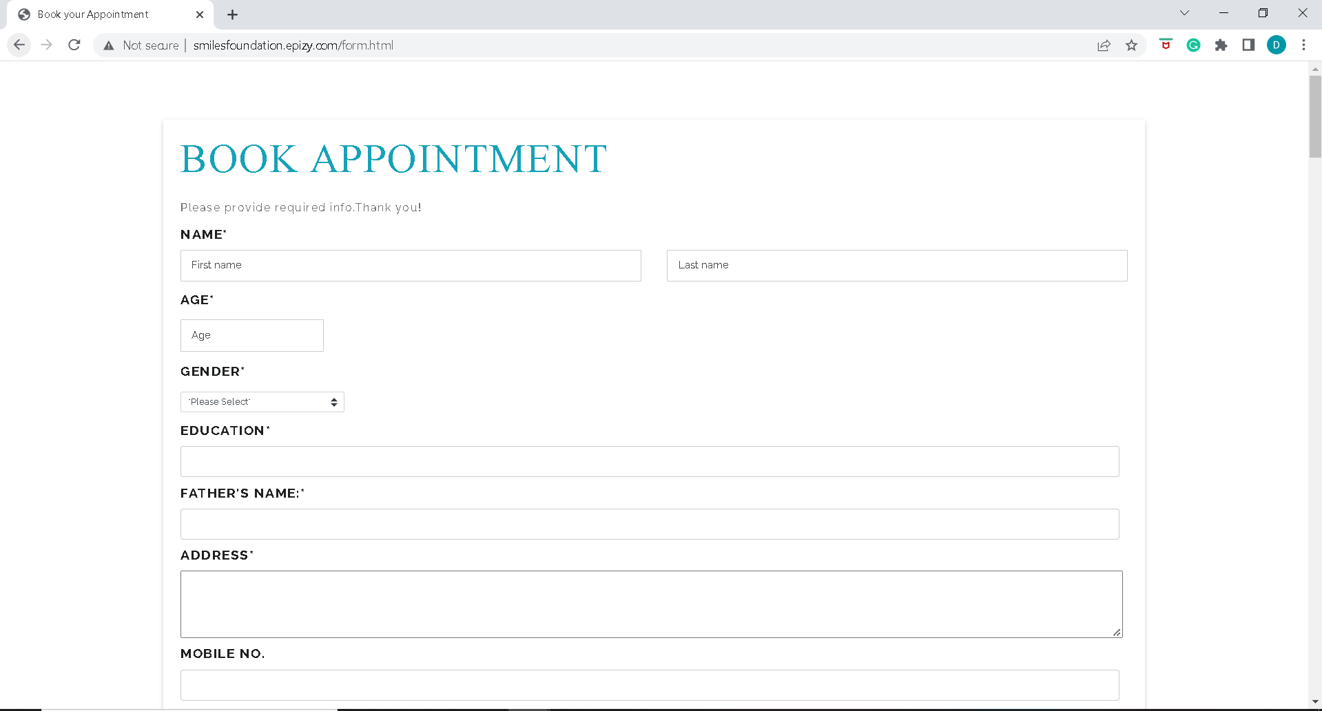
Enquiry/Case history performa
The user has to input basic demographic details like name,age,gender,education ,father’s name and address,mobile number and present issues faced by the autistic person.

Slide 22
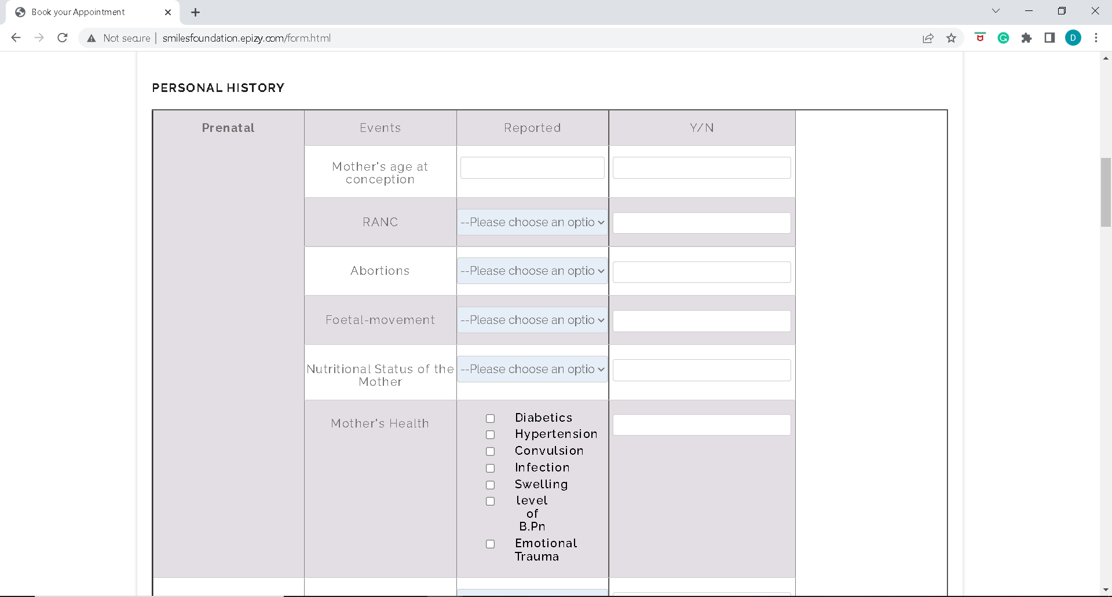
Personal History details which includes prenatal ,natal and post natal conditions should also be selected by the user because these details play a major role for diagnosing autism in children.

Slide 23
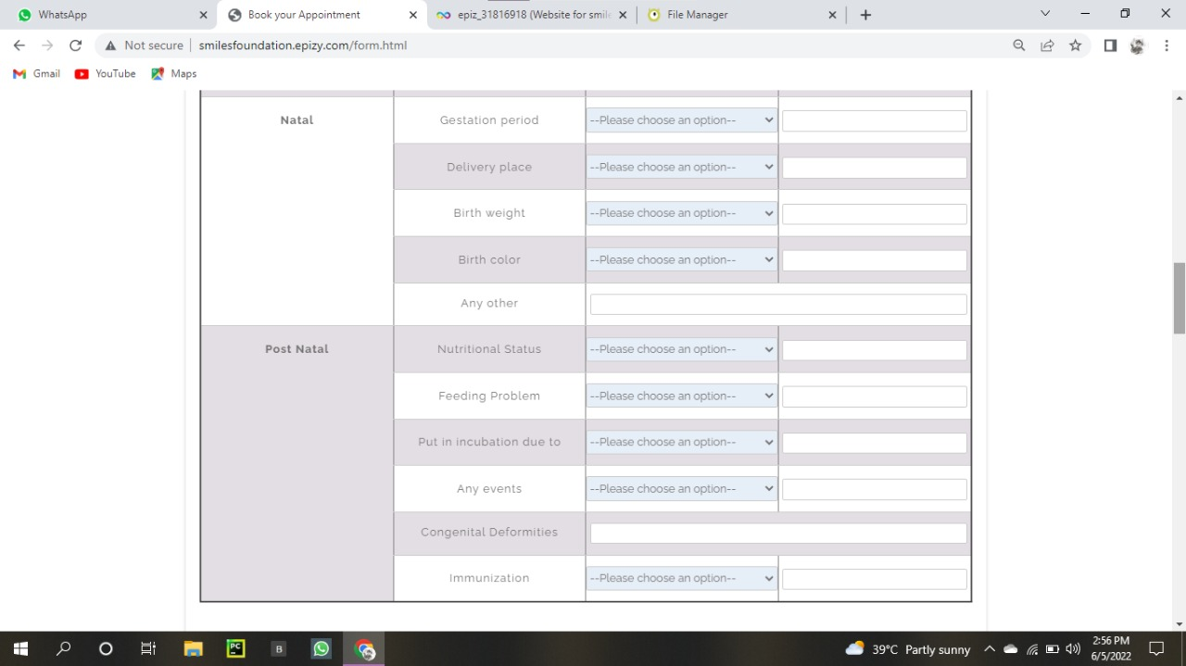

Slide 24
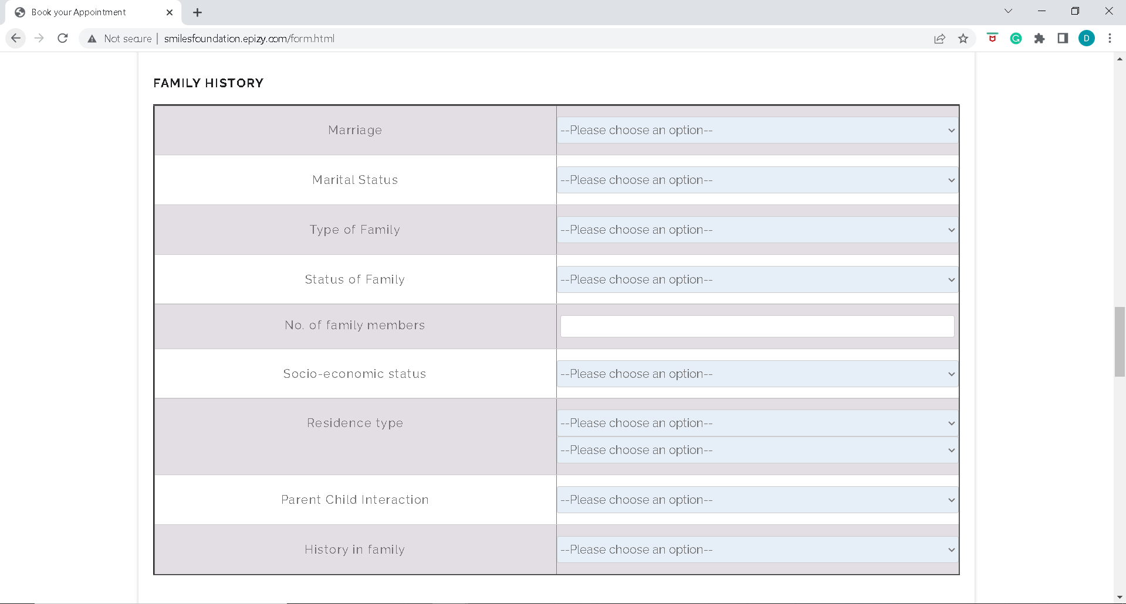
Details regarding family history should be selected.

Slide 25
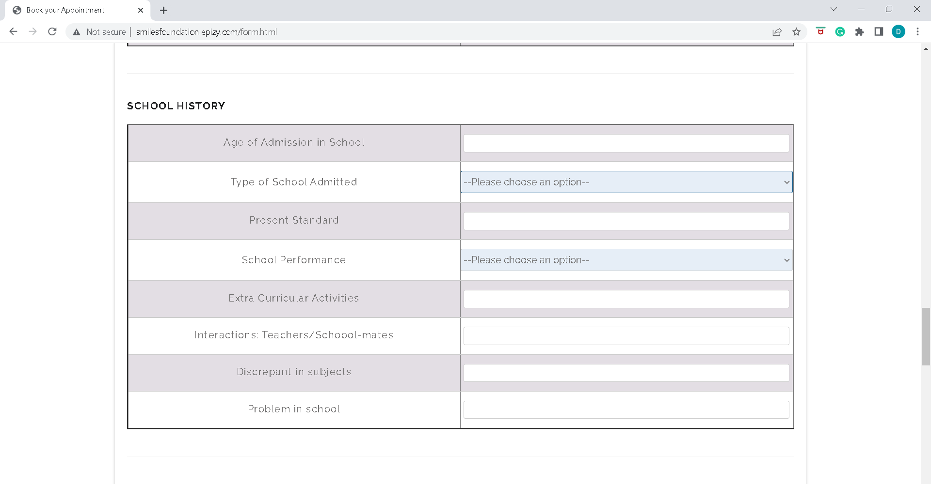
School history of the child details should be filled by the user.

Slide 26
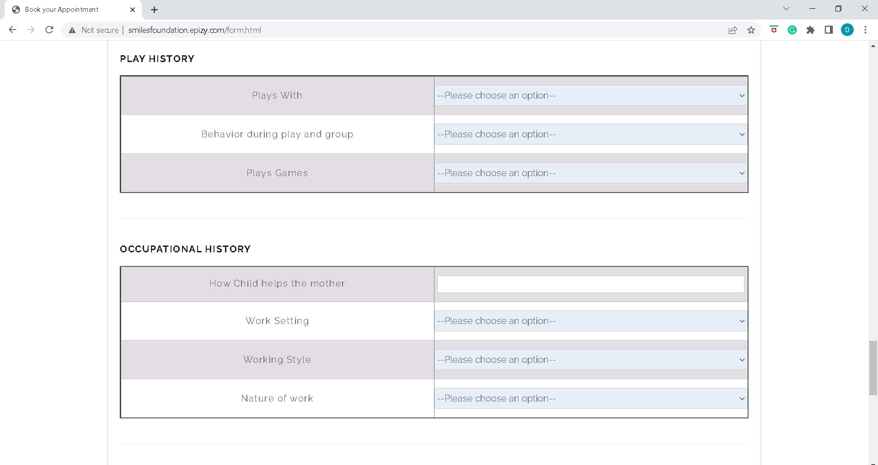
Play history and occupational history of the child should be selected. This is also a part of case performa.

Slide 27
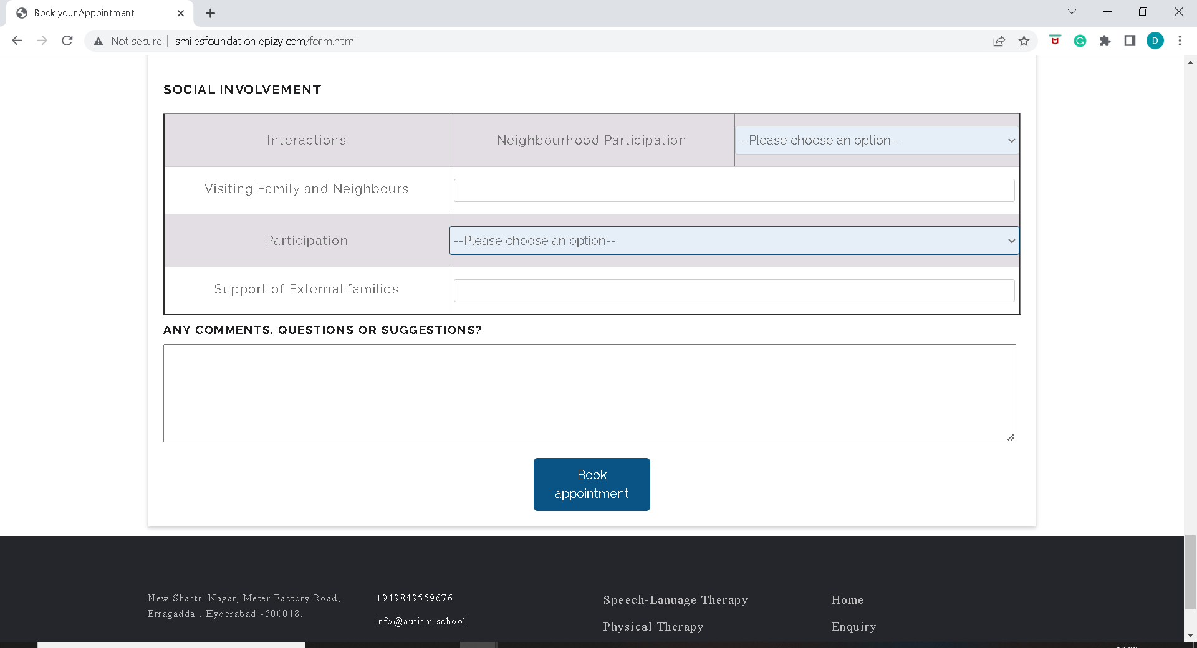
Social involvement details should be selected by the user and the user should click on book appointment.

Slide 28
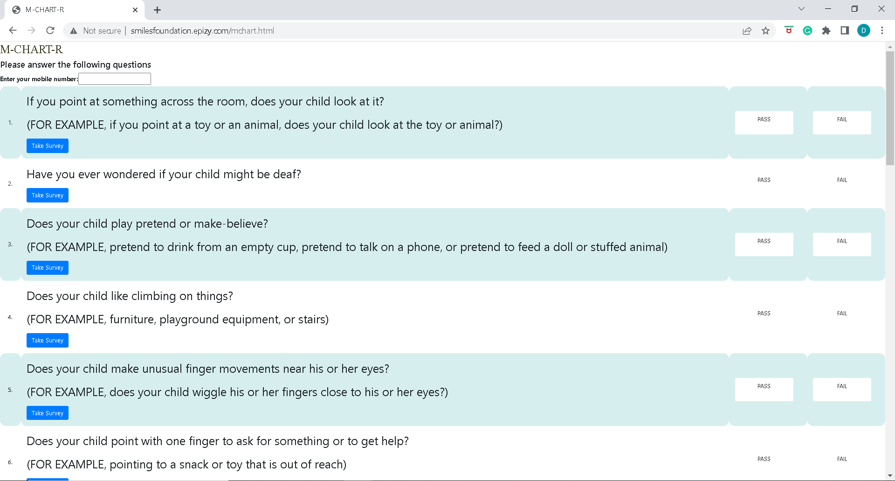
M-CHART
The M-CHAT™ (Modified Checklist for Autism in Toddlers) is a parent-report screening tool to assess the risk for Autism Spectrum Disorder (ASD).It is a psychological questionnaire that evaluates risk for autism spectrum disorder in children ages 16–30 months.

Slide 29
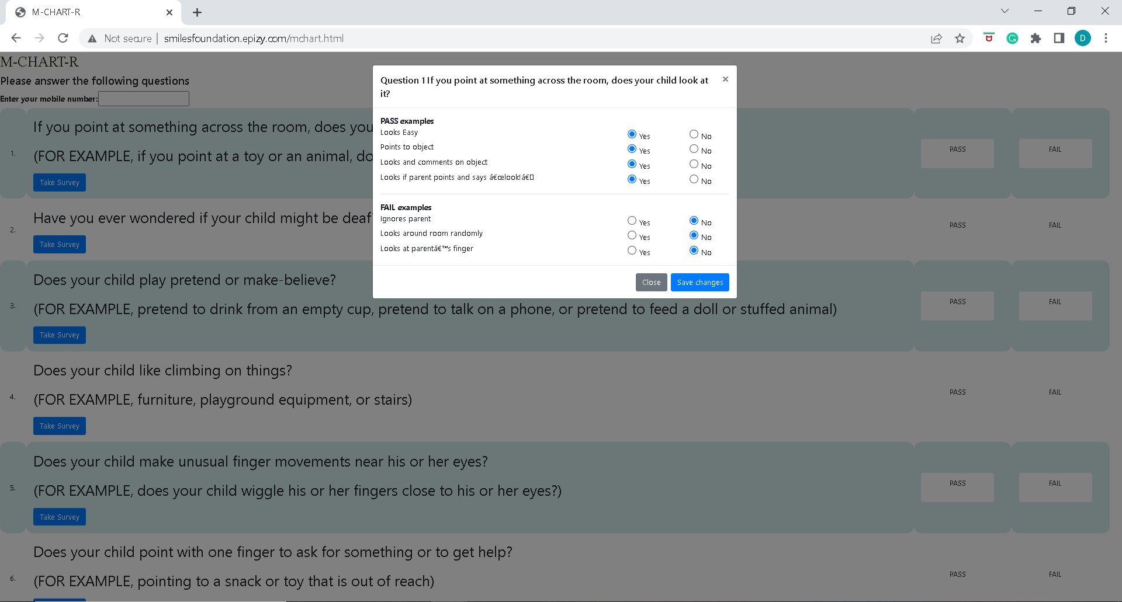
The user has to take the survey for every question based on which PASS or FAIL is calculated for that question.

Slide 30
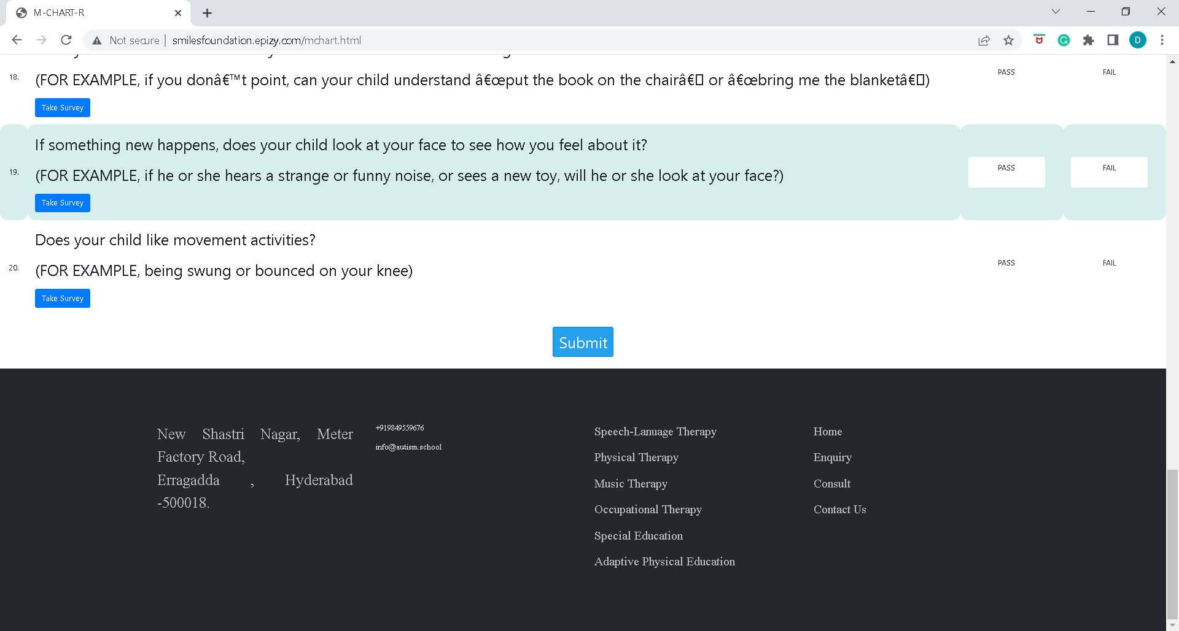
After selecting either pass or fail to all the questions in the mchart, the user should click on submit button to submit the
M-chart which will be stored in the database.

Slide 31
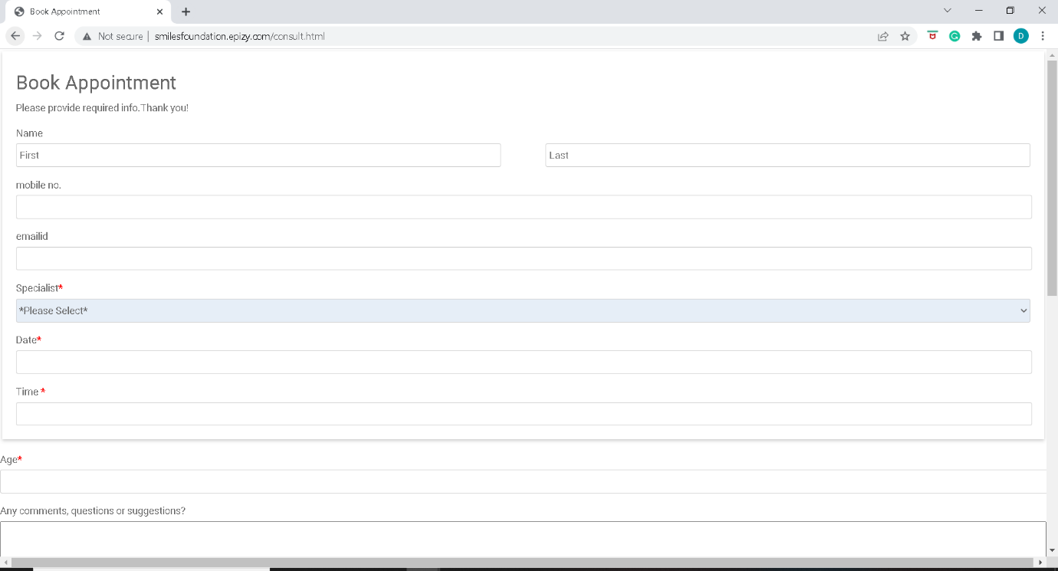
The user can schedule appointment with either a doctor or therapist by clicking on the CONSULT menu on the homepage.

Slide 32
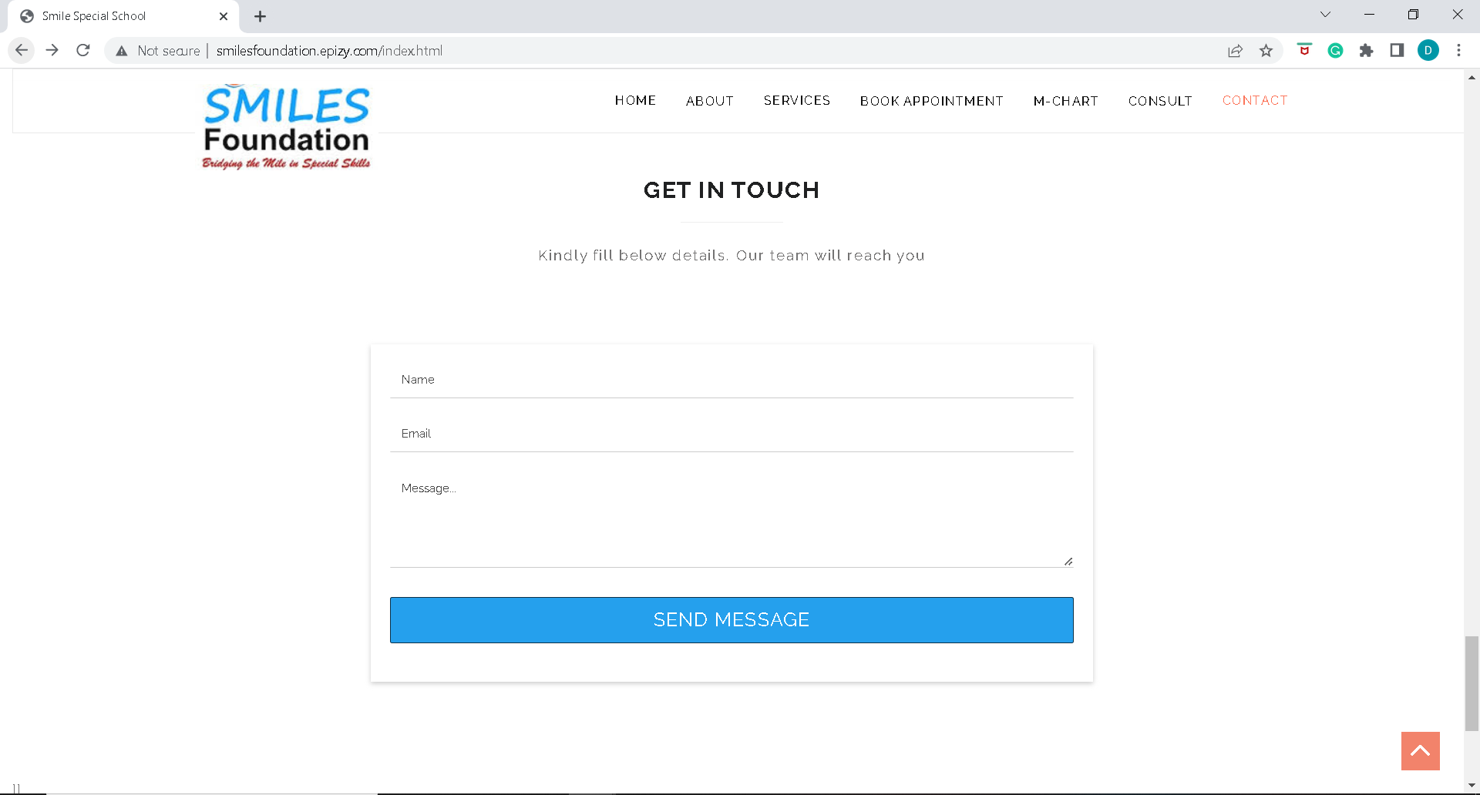
The user can schedule appointment with either a doctor or therapist by clicking on the CONSULT menu on the homepage

Slide 33
Future Scope
LMS System is to be added to the website where we can track all the student learnings, progress, reports. Parents also need to check the progress and provide necessary updates whether their child has shown significant improvement in the behaviour.
Improve scalability by separating client and server.
Additional features can be incorporated.

Slide 34
Conclusion
According to a survey, every 1 in 100 children below 10 years suffer with autism in India. There should be more number of schools and program to treat the autism children. Smiles Special School is one of them.
SMILES Special School serves both alternative education and therapy sessions.
It offers a special program based on three A’s - Acknowledge, Appreciate and Accept.
The alternative education include Speech-Language Therapy, Special Education, Occupational Therapy, Physical Therapy, Music Therapy and many other. This alternative education helps them to grow out in their life. It adds few life skills to their life. They gain confidence in life by adapting these skills.

Slide 35


